Slide 1
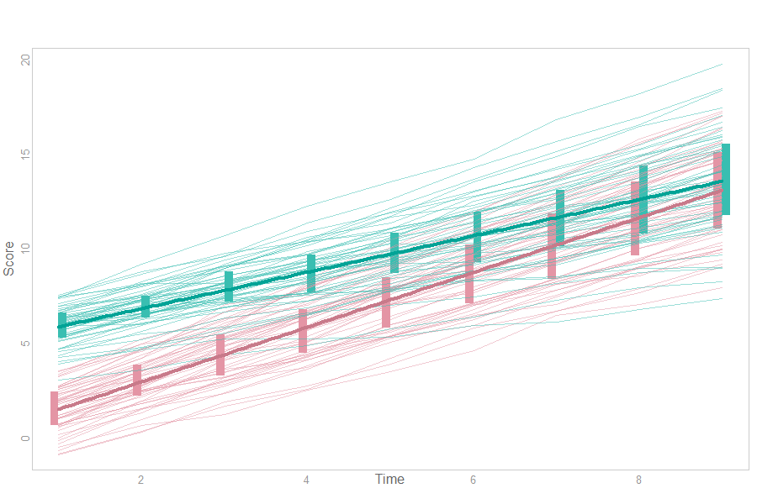
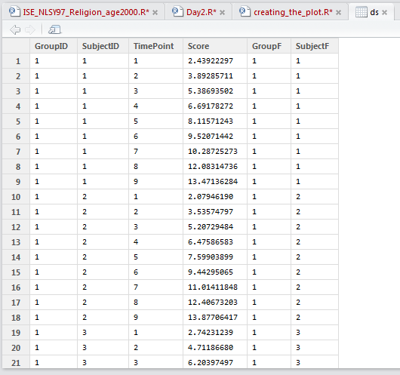
m7 <- lmer(Score ~ 1 + GroupF + TimePoint + GroupF*TimePoint + (1 + TimePoint | SubjectF), data=ds)
predictor
fixed
random

